Slide 1
Descriptive Statistics

Slide 2
Imagine you go to a party and you talk to 10 people. You get information on all 5 variables from each individual. Then when you are with a friend the next day you want to describe what you learned at the party.
As the number of individuals (the number of data points) goes up the harder this is to do.

Slide 3
Summaries
It is not easy to describe all the characteristics (lots of variables) of all of the members of a group (lots of people).
Summaries of the measures of the characteristics of the members of a group are called descriptive statistics.
One of the most common descriptive statistics is the measure of central tendency.

Slide 4
You first learned this in middle school: Measures of Central Tendency
Mode—the response that occurs most frequently
Median—the point where half of the scores are above and half below
Mean—average

Slide 5
Median
2
3
3
3
4
4
5
6
6
7
8
The point at which half the scores are higher and half are lower

Slide 6
Problems with Summarizing Information About Characteristics
Did you get the same information from each respondent?
Is the information appropriate to your problem?
Can you transform the information into numbers?
Are the numbers in a form that can be analyzed?
The solution to these problems is to use measurement scales.

Slide 7
Why We Need Different Summary Statistics
Data can be gathered with different kinds of scales
Each scale type has its preferred summary statistic
Nominal, Ordinal, Interval scales
Sometimes these are called:
Sorting, Ordering, and Counting

Slide 8
What color is your car?
Nominal—Mode
Sorting

Slide 9
Nominal Scales
Unordered classification
Think of this as a group of containers into which you will sort data.
Allows comparison of group sizes
Which container has the most in it?
No information is embedded in the order of the categories
Mode (the only measure of central tendency)

Slide 10
Do you like chocolate?
Ordinal—Median or Mode
Ordering

Slide 11
Ordinal Scales
Ordered classification
Containers where it makes sense that they are in order
Allows comparison of both group sizes and relative position of categories
Categories are ordered but not evenly spaced
The distance between the containers may not be equal
Median (best measure of central tendency) or Mode

Slide 12
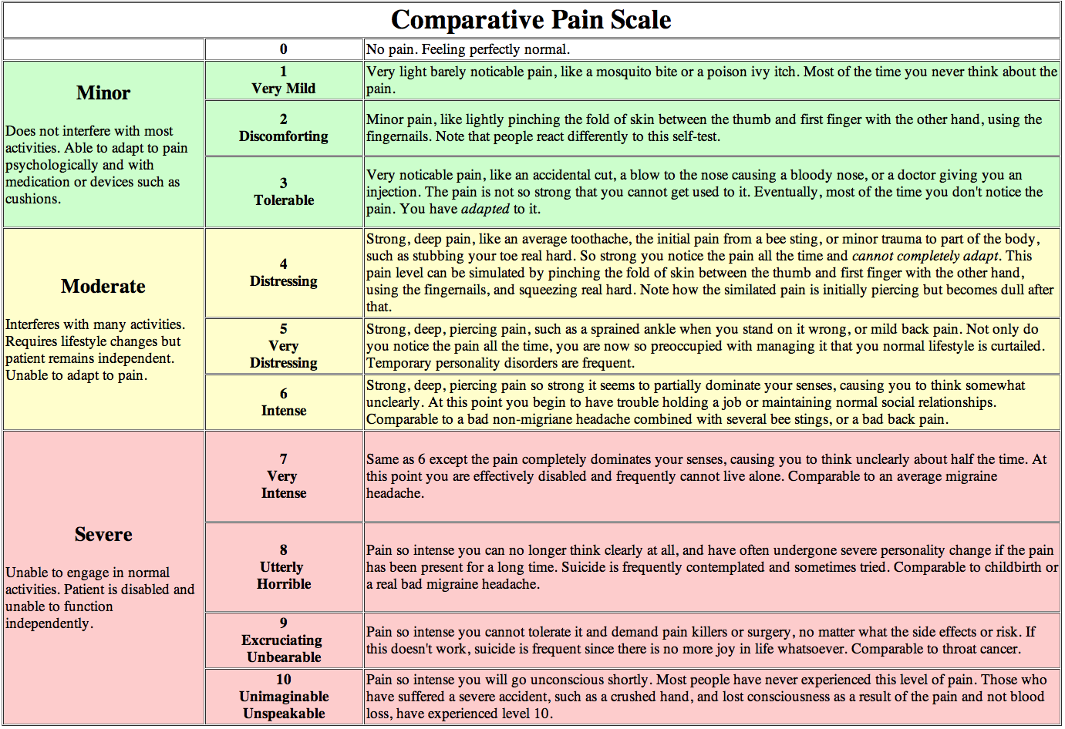

Slide 13
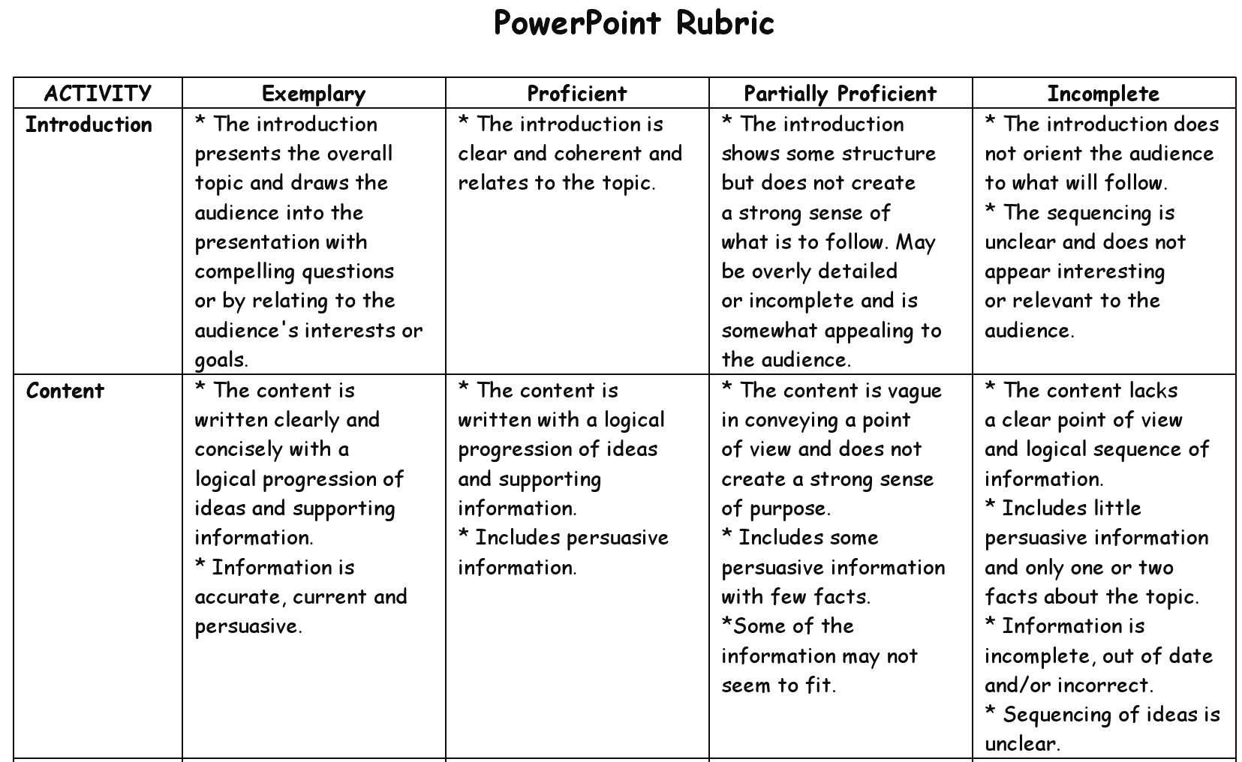

Slide 14
How many ham sandwiches did you eat last week?
Interval—Mean, Median or Mode
Counting

Slide 15
Interval Scales
Ordered Classification
Just like ordinal the order makes sense
Categories are ordered and evenly spaced
Unlike ordinal all of the containers are uniformly spaced
Mean (best measure of central tendency)

Slide 16
A Special Case of Interval Scales Ratio Scales
When “zero” on an interval scale represents an absence of the thing being measured it is called a ratio scale.
When measures are made with ratio scales then you can make ratio statements about the measures.
i.e., 80 centimeters is twice as long as 40 centimeters.

Slide 17
Non-Ratio Scales
Some interval scales have no “zero” point.
Most measures of cognitive ability are non-ratio scales.
It is not appropriate to make ratio statements about measures of cognitive ability.
You are unlikely to ever statistically deal with ratio and non-ratio scales differently but it still important to know the difference to avoid making ratio statements about non-ratio data.

